Slide 1

INDE4488 – Enterprise Resource Planning Interview Assignment Presentation
Company Name: | AL_Neam Food
ERP Software used: | Microsoft Dynamics 365 SAP ERP
BPM Software used: | company plans to use BPM software to improve how work is managed
Other integrated Software: | (WMS), (CRM), (SCM) , (QMS)
Role of the Interviewer in the company: | Production Manager
Feras Mohammad
19INDE1086
30/12/2024

Slide 2

Company Background
Location: Benghazi, Libya started at 2009.
Business Operations (SCM) : Source materials from Brazil, India, China, Spain and Turkey
Food Products: (oils, sugar, rice, pasta,…)
Web Link: Neam Food – Neam Food

Slide 3

Interviewer Background and Role in the Company
Production Manager at Al-Neam Company Mohammad Al Jammaini (3 years).
Production Manager at Al-Angam Company, Jordan (6 years)
Worked in the IT department for 2 years earlier in his career
Bachelor's Degree in Industrial Engineering (Jordan)
Master's Degree in Operations Research (Germany)

Slide 4
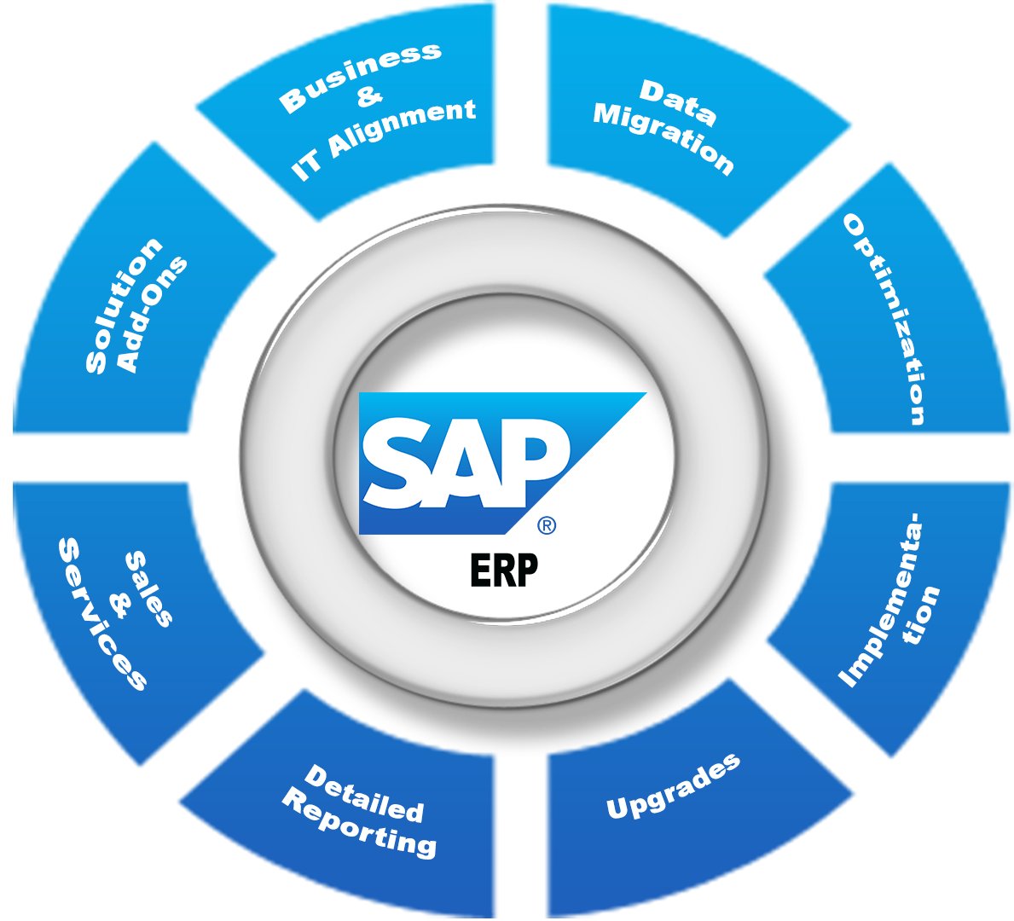
ERP Software and its Features
SAP ERP: Systems, Applications, and Products
Solved slow manual work and lack of connection between departments
Saves time, reduces mistakes, Improves teamwork
Easier tracking of raw materials and finished products

Slide 5
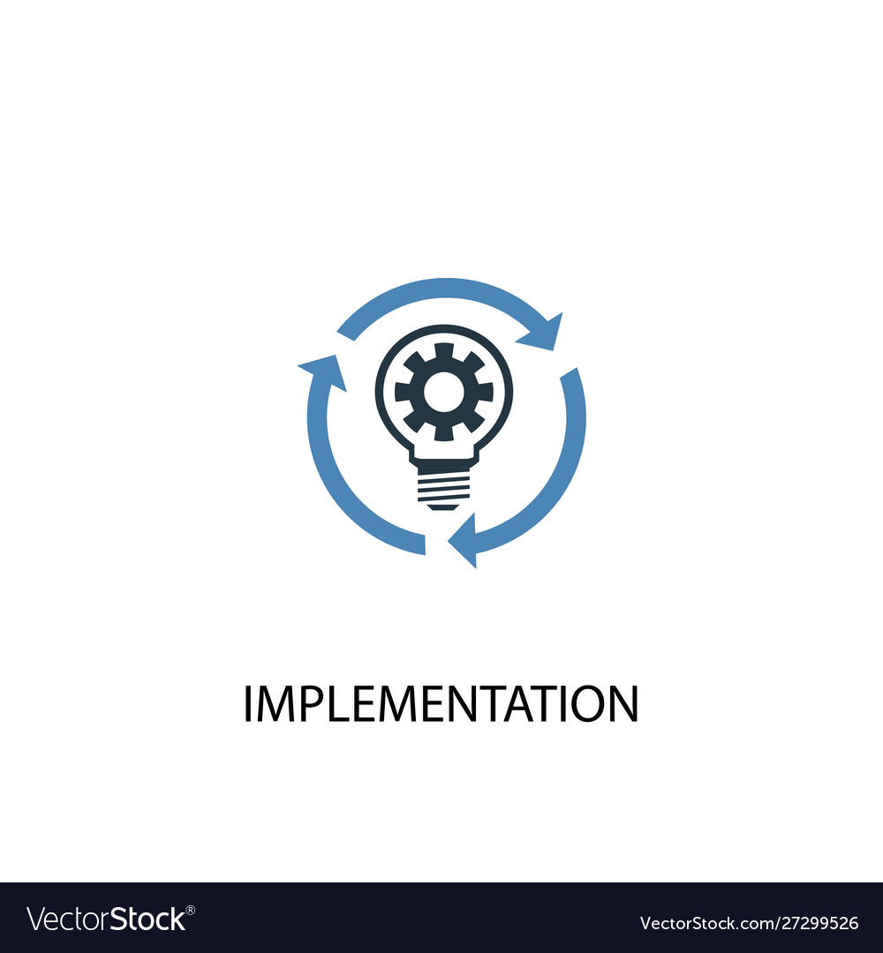
Implementation
Before: Fixed issues in inventory management
During: Improved production planning
After: Focused on improving reporting for better data use
“They had a problem connecting other software to ERP software “

Slide 6
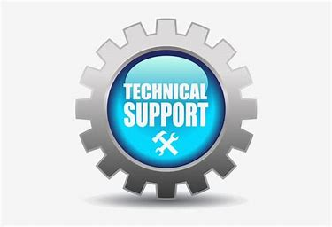
Maintenance and Support
IT Department monitors ERP system to ensure smooth operation.
Production and Finance departments working together for specific needs.
They have contact with ERP vendor for advanced support and updates.

Slide 7

Integration
The ERP system integrates with accounting and inventory software.
Al-Neam plans to use BPM software to automate tasks and improve efficiency.

Slide 8

Employee Experience
Al-Neam Food has seen a positive shift in its work culture, with the ERP system making tasks easier and faster.
Improved coordination between departments has helped resolve conflicts.

Slide 9

Digitalization and AI
AI is not yet used in their operations, but The company plans to integrate AI for demand forecasting and improved decision-making to boost efficiency and reduce errors.

Slide 10

Final Thoughts of the interviewer
ERP systems and BPM will improve with new technologies like AI, becoming more connected and friendly.
BPM will simplify processes, save time, and reduce errors.
The future of ERP and BPM will focus on making businesses more productive and easier to use.

Slide 11

My Final Thoughts
In my opinion ERP and BPM will be not be important but will be super important in the future with all the new tech coming out like (AI) ,ERP systems will be able to do a lot more and be smarter they will help companies make decisions faster which will be huge for staying competitive.

